Slide 1
Cross-Portfolio Hackathon: AI Products

Slide 2





AI Product Hackathon Our Understanding Based On February 12th Call
An in-person, participant-led hackathon focused on building AI products, backed by strategic partners and sustained through structured post-event accountability, to deliver measurable portfolio impact.
Strategic Focus
Prioritise Product & AI capability development over AI tooling. Deliver high-impact outcomes that resonate with portfolio leadership and serve as a compelling proof point for LPs and fundraising communications.
In-Person Collaboration
An in-person format is essential to foster cross-portfolio energy, build relationships, and maximise creative collaboration with 20–30 portfolio companies across Elevate and Capital funds.
Participant-Led Projects
Teams of 4 - 6 per company (~125 participants) will propose leadership-endorsed (CEO approved) projects addressing genuine operational challenges and ensuring real-world applicability.
Ecosystem & Accountability
Strategic partners (AWS, Microsoft, OpenAI) provide credits and on-site expertise. Partners see Eurazeo as an available and valuable partner for deeper engagement.
Awards for Recognition
Small symbolic awards to drive competition motivation. Prestige of winning can be a key motivator, even if the monetary amount is low.
Post-event Tracking & Community Networking
Post-event tracking (90/180 days) is critical to convert hackathon output into lasting value.

Slide 3
AI Product Hackathon Why This Approach and Why Now
PRIMARY
Surface and build real AI use cases within 24 hours, generating real portfolio P&L impact
SECONDARY
Build cross-portfolio community and shared AI call to action
SECONDARY
Generate LP-facing content showcasing AI value creation across the portfolio

Slide 4
AI Product Hackathon Execution To Start In Mid-March, Enabling Late May Event
17–28 Mar
31 Mar–11 Apr
14–25 Apr
28 Apr–9 May
12–16 May
18–22 May
23–30 May
Jun–Nov
WK 1–2
WK 3–4
WK 5–6
WK 7–8
WK 9
EVENT
WK 11
WK 12+
Lock budget tier & confirm scope
Partner outreach & AI credits
Company invitations & challenge design
Registration, teams & enablement
Final logistics & dry run
24-Hour Hackathon Kick-off → Judging
Post-event survey & follow-up
90/180-day impact tracking
PRE-EVENT PREPARATION
EVENT WEEK (18–22 MAY)
POST-EVENT TRACKING
Wk 1–2 Lock budget tier (Gold / Silver / Bronze), confirm May date, approve partner outreach list
Mon Hype email sent; final prep meetings with kick-off speakers & partners
Wk 11 Follow-up tracking emails sent; post-event survey & feedback analysis
Wk 3–4 Secure AWS, Microsoft & OpenAI credits and begin sponsor negotiations
Tue Kick-off opening & welcome; hackathon begins with ongoing partner support
+90 days First impact checkpoint — entry / exit criteria assessment per project
Wk 5–6 Send portfolio company invitations, design challenge briefs, open registration
Wed 24-hr hacking continues; celebration lunch; team presentations & judging
+180 days Final impact report — sustained enterprise value measurement & LP comms
Wk 7–8 Team formation (4–6 per company), partner-led enablement, hype communications
Wk 9 Final logistics, rehearsal dry run, speaker & partner prep meetings
Thu Event summary distributed; post-event survey & feedback capture launched

Slide 5
AI Product Hackathon Budget Summary
GOLD
SILVER
BRONZE
€253k
€173k
€109k
Text
Text
Text
Text
Text
Text

Slide 6
AI Product Hackathon Budget Breakdown by Tier
Category | Gold | Silver | Bronze
Venue (Note: may need to pay overtime costs) | € 0 | € 0 | € 0
Catering (meals + overnight) | € 30,000 | € 25,000 | € 20,000
Travel & Hotels (subsidized) | € 50,000 | € 25,000 | € 0
Technology / Partner Setup | € 15,000 | € 10,000 | € 7,000
Video Production (LP content) | € 25,000 | € 12,000 | € 0
Awards / Prizes | € 10,000 | € 5,000 | € 0
Yelin.io Program Fees | € 90,000 | € 80,000 | € 75,000
Contingency | 15% | 10% | 7%
Estimated Total | € 253,000 | € 172,700 | € 109,140
Estimated Count of Companies | 25 | 25 | 25
Estimated Cost per Company | € 10,120 | € 6,908 | € 4,365
Estimated Attendees per Company | 5 | 5 | 5
Estimated Cost per Attendee | € 2,024 | € 1,381 | € 873

Slide 7
AI Product Hackathon Summary of Roles for Participating Parties
Yelin.io Provides | Partners Provide | Eurazeo Provides
Program design & facilitation | Free API credits & software seats | Venue selection & booking
Project proposal review & coaching | Technical mentors on-site | Portfolio company communications
Pre-event prep workshops | Swag & branded materials | Internal budget approval
Day-of event management | Best practice sessions | LP/investor audience (optional)
Post-event tracking & reporting | Post-event technical support | Video production vendor (Gold tier)

Slide 8
Portfolio Archetypes

Slide 9
Portfolio Archetypes
SaaS…

Slide 10
Portfolio Archetypes
Services…

Slide 11
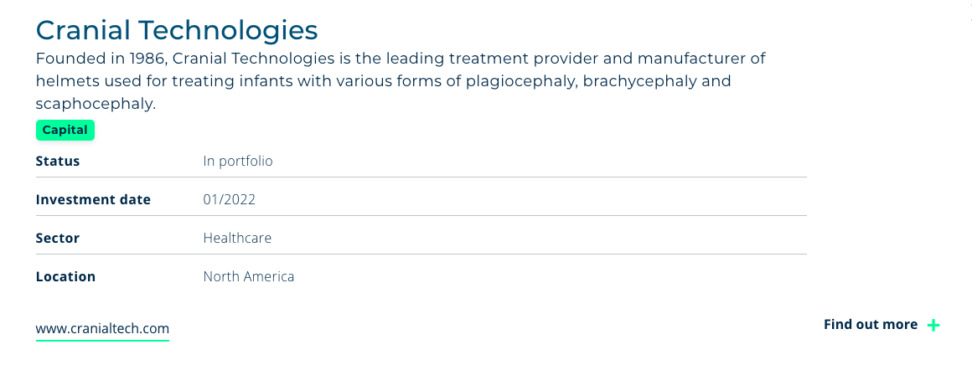
Portfolio Archetypes
Manufacturing…

Slide 12
Event Value by Stakeholder

Slide 13
Event Value by Stakeholder
Portfolio Company Value Proposition

Slide 14
Event Value by Stakeholder
Eurazeo Value Proposition

Slide 15
Event Value by Stakeholder
LP Value Proposition

Slide 16
Event Value by Stakeholder
3rd Party Partner Value Proposition

Slide 17
Example Across Entry / Exit / Future

Slide 18
AI Product Hackathon Portfolio Company Example of Entry / Exit / Future
Entry: Team Registration and Project Proposal
Field | Details
Company | Portfolio Co. (B2B SaaS, 200 employees)
Team | 5 people: 2 engineers, 1 product manager, 1 customer success lead, 1 data analyst
Project Idea | AI-powered configuration assistant for new customer onboarding
Customer Pain Point | Customers take 3-6 weeks to fully configure the platform; 40% of support tickets in the first 90 days are setup-related. Churn risk is highest during onboarding.
Planned Approach | Build a conversational AI assistant that reads the customer's existing data/preferences and recommends configuration settings, reducing manual setup from days to minutes
Tools & Resources | OpenAI API credits (provided by partner), existing product APIs, sample anonymized customer data
Success Criteria | Working prototype that can auto-configure 70%+ of a standard customer setup

Slide 19
AI Product Hackathon Portfolio Company Example of Entry / Exit / Future
Exit: 24 Hours Later - Demo & Results
Field | Details
Deliverable | Live demo of a working chatbot embedded in the product's onboarding flow
What It Does | Ingests customer profile data > asks 5-7 clarifying questions > generates a recommended configuration > applies it with one click
Demo Scenario | Simulated new customer onboarded in ~8 minutes vs. current 2-week average
Target ICP | Mid-market customers (50-500 seats) with standard use cases, ~60% of new bookings
Estimated Impact | 50% reduction in onboarding time, 30% fewer early-stage support tickets, measurable improvement in time-to-value
Go/No-Go Decision | ✅ Proceed: team validated feasibility; next step is a 6-week pilot with 5 real customers
Open Questions Identified | Edge cases for complex enterprise configs, data privacy review needed, cost per API call at scale

Slide 20
AI Product Hackathon Portfolio Company Example of Entry / Exit / Future
Future: 6 months post-hackathon
Field | Details
Product Status | AI configuration assistant shipped to production; available to all new customers as part of standard onboarding
Adoption | 75% of new mid-market customers using the assistant; enterprise rollout in beta
Onboarding Impact | Average time-to-go-live reduced from 3-6 weeks to 1 week; onboarding NPS up 20 points
Support Savings | Early-stage support tickets down 35%, equivalent to ~1.5 FTEs redeployed to higher-value work
Revenue Impact | Faster onboarding leading to faster time-to-value; 15% improvement in first-year retention; feature cited in 3 competitive wins
Commercial Leverage | Assistant repositioned as a premium onboarding capability in sales demos; included in updated investor materials
LP Story | One team, 24 hours, and an idea that became a shipped product driving measurable retention and revenue impact across the customer base.

Slide 21
Appendix

Slide 22
AI Product Hackathon Designed To Kick Start AI Learning and Roadmap
Hackathons are a time-tested approach to stimulating innovation. They are low-cost, distributed, bottoms-up enablers for generating new skills, new ideas, and new products to eventually sell.
New Ideas
Encourage fresh thinking in how AI can be applied to fit each company’s customers and market position
Business Value
Find practical ways to increase company value, drive growth, and improve competitiveness at scale across the portfolio
Cross-Portfolio Shared Learning
Promote knowledge exchange and useful practices across your portfolio of companies and professionals
Skill Building
Develop stronger AI skills within portfolio companies through hands-on work and peer learning, preparing for the future

Slide 23
AI Hackathon Three Potential Focus Area For AI Hackathon
1
2
3
AI Products
AI Tooling: Engineering
AI Tooling: Go-to-Market
Goal: create new AI features or capabilities in the company’s customer-facing product or service
Specific activities:
Identify a customer-facing workflow where AI can remove friction or create a net-new capability to sell
Build a working prototype (or clickable demo) of an AI feature, assistant, or automation
Define MVP scope, success metrics, and a credible path to production (data, UX, risk, cost)
Goal: utilize AI tooling to enhance the productivity of Engineering while maintain or improving code quality
Specific activities:
Pilot AI-assisted development on a real repo (new feature, refactor, bug fix) and ship a PR
Use AI to generate tests, improve coverage, and harden quality gates (linting, review, CI checks)
Measure impact with simple metrics (cycle time, PR throughput, defects, on-call load) and document learnings
Goal: utilize AI tooling to enhance the productivity of Go-to-Market, without risking reputation or relationships
Specific activities:
Create a safe AI workflow for account research and outreach personalization using approved messaging
Build a sales enablement copilot for FAQs, objections, and competitive positioning from curated content
Automate low-risk GTM ops with human-in-the-loop controls

Slide 24
AI Hackathon Three Potential Focus Area For AI Hackathon – Possible Tooling
1
2
3
AI Products
AI Tooling: Engineering
AI Tooling: Go-to-Market
While not the primary focus, tooling can help to accelerate achievements attained during the hackathon:
Figma Make
Base44
Replit
Lovable
Canva
Recommended Approach
Most AI engineering tools allow free usage for individual users with rapid self-serve capabilities:
Claude Code
Cursor
GitHub Copilot
Replit
Lovable
To enable usage during the hackathon, tools will need to offer free trials with self-serve usage:
Clay
Apollo.io
Granola
Gong.io
Lemlist

Slide 25
AI Hackathon Two Potential Hackathon Event Types
1
2
In-Person Hackathon
Fully Remote Hackathon
A 24-hour, co-located event designed to maximize energy, collaboration, and cross-portfolio relationships.
Strongest networking and shared learning across companies
Faster iteration with on-site mentors and real-time team support
Natural structure for kickoff, meals, demos, and judging
Higher cost and coordination: travel, venue, catering, scheduling constraints
A 24-hour, distributed event optimized for speed, cost, and broad participation across the portfolio.
Lowest cost and fastest to execute, no travel required
Easy to include more companies, judges, and external partners as needed
Works well with lightweight tooling (video, chat, shared docs) and scheduled check-ins
Requires tighter facilitation: time zones, engagement fatigue, and clear touchpoints to maintain momentum
Recommended approach for maximum impact
While hackathons are typically 24-hour sprints, they can also be 48-hour or even 72-hour events. This allows for deeper work and better balance with ongoing “day job” activities, if needed.

Slide 26
Logistics and Approach

Slide 27
Hackathon Logistics Proposed Approach
Four high-level steps are generally needed:
Align
Plan
Run
Nurture
Goal: Build understanding of event purpose and get buy-in from firm and portfolio leadership
Specific activities:
Define objectives
Test interest from portfolio company executives
Set expectations around time commitment, judging criteria, and outcomes
Identify potential partners to support event
Goal: Create a clear roadmap and logistics plan to ensure smooth execution of the event
Specific activities:
Establish timeline and milestones
Recruit teams and confirm participants
Arrange tools, platforms, and comms channels
Finalize judging panel, scoring rubric, and awards
Goal: Deliver an engaging and well-organized hackathon experience for all participants
Specific activities:
Kick off with orientation and rules of engagement
Provide ongoing support and check-ins for teams
Host judging session and presentations
Announce winners and celebrate achievements
Goal: Ensure hackathon outcomes translate into real business impact and prioritize on roadmaps
Specific activities:
Track progress of hackathon projects and share success stories
Debrief with teams and capture learnings
Identify top ideas and evaluate feasibility for roadmaps

Slide 28
Hackathon Logistics In-Person 24-Hour Hackathon: Sample Week
Time | Monday | Tuesday | Wednesday | Thursday
8 AM
9 AM
10 AM
11 AM
12 PM
1 PM
2 PM
3 PM
4 PM
5 PM
6 PM
7 PM
8 PM
9 PM
10 PM
11 PM
12 AM
Hackathon Reminder and “Hype” Email Sent Out
Breakfast
Hackathon Closing and Team Presentations + Judging
Event Summary and Follow Up Tracking Email Sent Out
Hackathon Kick Off and Opening Remarks
Final Prep Meetings With Kick Off Speakers + Partners
Launch Post-Event Survey and Feedback Capture
Ongoing Hacking
Ongoing Partner Support
Celebration Lunch
Kick Off Opening / Welcome
Kick Off Event
Dinner
Open Networking / Cocktails

Slide 29
Hackathon Logistics What Do Hackathon Teams Work On?
Hackathon teams decide for themselves which problems or opportunities are most valuable to work on, ensuring the effort is relevant and impactful. Portfolio company leadership provides approval to ensure commercial relevance, but the process is driven bottoms-up. This approach distributes innovation and surfaces ideas that might not otherwise be known or prioritized.
Teams are encouraged to target ideas that can be piloted quickly but scaled if successful.
Potential outputs include product features, workflow automations, or new customer-facing capabilities.
Even ideas that don’t make it to production can spark insights that inform future priorities.
Business impact is considered from the start, aligning innovation with growth and efficiency goals.

Slide 30
Hackathon Logistics Registration Captures Important Details
Hackathon Team Registration Form
Team Information
Project description, AI use case, customer impact, value prop
Company and team name
Primary contact (name, email, phone)
List of team members (name, role, email)
Team Composition
5. How many software developers are on your team? 6. Do you have any team members with prior hackathon experience? AI Experience and Tools
7. Is your team currently using any AI tools in your day-to-day work? 8. Do you have experience working with Agentic AI (AI systems that can take actions or perform tasks with some autonomy)? Logistics
9. Do you have any specific support needs during the hackathon? (e.g., data access, cloud credits, product documentation) 10. T-shirt sizes for team members
Portfolio company leadership can nominate 1-2 teams to participate in the hackathon. While registering, each team provides detailed information that helps with event planning and also helps to gauge their level of capability in AI systems, tools, and techniques.
This data can be used to provide appropriate mentorship and training before or during the event. Additionally, participants can be guided toward using the right level of AI tooling.

Slide 31



Hackathon Logistics Pre-Event Enablement Requested From Leading Vendors
Prior to the event, multiple enablement sessions can be facilitated. These would help hackathon participants to start to think through the art of the possible and also upskill them on AI.

Slide 32
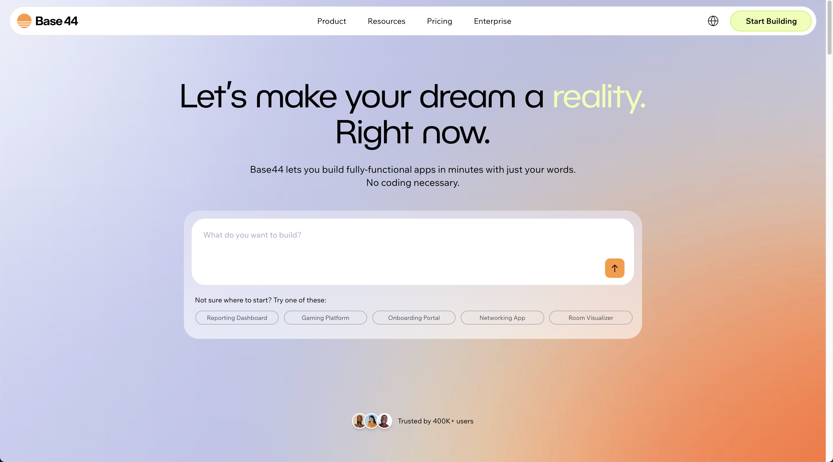
Hackathon Logistics Multiple Ways For Non-Software Companies To Participate
New AI tooling enables the creation of incredible software and AI bots using just a few words. Even stopping short of building software, enabling hackathon teams to think through what a new offering could look like – and building a business case around it – still delivers real impact.
Base44 can be used to build an app in minutes, with nothing more than free-text. This is a great way to rapidly prototype and learn about AI in a low-cost, low-risk setting.

Slide 33
Thank You
Henry Yelin
Michael Duncan
Russell Beggs

